Slide 1
Deep Learning Course
Foundation
Introduction to Deep Learning
Notes:
In the first session, you will:
- meet your peers and teacher
- understand what deep learning is
- the history of deep learning and how it is changing the world
- be introduced to perceptrons, forward and back propagation, multi-layer perceptrons.

Slide 2
What is Deep Learning?
What is Artificial Intelligence?
What is Machine Learning?
Notes:
To explain deep learning, we first need to understand what is artificial intelligence and what is machine learning.

Slide 3
Artificial Intelligence
Field of study in Computer Science that started in the 1950’s.
Can machines think? How to formalize reasoning?
A program solves problems without the developer have to think of every single situation.
Made purely of a list of logical and mathematical functions (rules).
Extensive code and long development time.
Artificial Intelligence
Notes:
Artificial intelligence was born in the 1950s, when a handful of pioneers from the nascent field of computer science started asking whether computers could be made to “think”—a question whose ramifications we’re still exploring today
problems that can be described by a list of formal, mathematical rules. The true challenge to artiﬁcial intelligence proved to be solving the tasks that are easy for people to perform but hard for people to describe formally—problems that we solve intuitively, that feel automatic, like recognizing spoken words or faces in images.

Slide 4
Artificial Intelligence
Artificial Intelligence
Data
Answer
Rules

Slide 5
Artificial Intelligence
IBM’s Deep Blue chess-playing system defeated world champion Garry Kasparov on 1997.
Requires knowledge of a limited world.
Makes decision based on the current state of the world.
Cyc.
Statements made with natural language.
The staff wrote all statements.
The story of “Fred shaving in the morning”.
Artificial Intelligence
Notes:
IBM’s Deep Blue chess-playing system defeated world champion Garry Kasparov in 1997 (Hsu, 2002). Chess is of course a very simple world, containing only sixty-four locations and thirty-two pieces that can move in only rigidly circumscribed ways. Devising a successful chess strategy is a tremendous accomplishment, but the challenge is not due to the diﬃculty of describing the set of chess pieces and allowable moves to the computer. Chess can be completely described by a very brief list of completely formal rules, easily provided ahead of time by the programmer.
Cyc is an inference engine and a database of statements in a language called CycL. These statements are entered by a staﬀ of human supervisors. It is an unwieldy process. People struggle to devise formal rules with enough complexity to accurately describe the world. For example, Cyc failed to understand a story about a person named Fred shaving in the morning (Linde, 1992). Its inference engine detected an inconsistency in the story: it knew that people do not have electrical parts, but because Fred was holding an electric razor, it believed the entity “FredWhileShaving” contained electrical parts. It therefore asked whether Fred was still a person while he was shaving.

Slide 6
Machine Learning
A branch of AI.
Uses data for learning.
This data is used to change several parameters in a logical or mathematical function.
There are functions used during the learning. There are functions used during the inference.
Artificial Intelligence
Machine Learning
Notes:
A machine-learning model transforms its input data into meaningful outputs, a process that is “learned” from exposure to known examples of inputs and outputs

Slide 7
Machine Learning
How does the machine learn?
Uses the data to create the rules.
Requires 3 components:
Input data.
Expected answers.
Measurement of the rules’ quality.
Compares the expected answers with the answers given with the current set of rules. “Is it doing well?”.
Improves the rules to try to have better answers.
Artificial Intelligence
Machine Learning
Notes:
Input data points—For instance, if the task is speech recognition, these data points could be sound files of people speaking. If the task is image tagging, they could be pictures.
Examples of the expected output—In a speech-recognition task, these could be human-generated transcripts of sound files. In an image task, expected outputs could be tags such as “dog,” “cat,” and so on.
A way to measure whether the algorithm is doing a good job—This is necessary in order to determine the distance between the algorithm’s current output and its expected output. The measurement is used as a feedback signal to adjust the way the algorithm works. This adjustment step is what we call learning

Slide 8
Machine Learning
Data
Artificial Intelligence
Rules
Answers
Machine Learning
Data
Answer
Rules
Notes:
After we have the generated rules, we can use it for inference.

Slide 9
Machine Learning
The data influences the generated rules.
Bad data can create bad rules.
Data formats changes the rules.
Some data formats make it easier for the machine to learn.
Artificial Intelligence
Machine Learning

Slide 10
Machine Learning
Branches/Branches of Machine Learning:
Regression Algorithms
Instance-based Algorithms
Regularization Algorithms
Decision Tree Algorithms
Bayesian Algorithms
Association Rule Learning Algorithms
Deep Learning Algorithms *
Artificial Intelligence
Machine Learning
Notes:
**Regression Algorithms
Regression Algorithms Regression is concerned with modeling the relationship between variables that is iteratively refined using a measure of error in the predictions made by the model. Regression methods are a workhorse of statistics and have been co-opted into statistical machine learning. This may be confusing because we can use regression to refer to the class of problem and the class of algorithm. Really, regression is a process.
The most popular regression algorithms are:
Ordinary Least Squares Regression (OLSR)
Linear Regression
Logistic Regression
Stepwise Regression
Multivariate Adaptive Regression Splines (MARS)
Locally Estimated Scatterplot Smoothing (LOESS)
**Instance-based Algorithms
Instance-based AlgorithmsInstance-based learning model is a decision problem with instances or examples of training data that are deemed important or required to the model. Such methods typically build up a database of example data and compare new data to the database using a similarity measure in order to find the best match and make a prediction. For this reason, instance-based methods are also called winner-take-all methods and memory-based learning. Focus is put on the representation of the stored instances and similarity measures used between instances.
The most popular instance-based algorithms are:
k-Nearest Neighbor (kNN)
Learning Vector Quantization (LVQ)
Self-Organizing Map (SOM)
Locally Weighted Learning (LWL)
Support Vector Machines (SVM)
**Regularization Algorithms
Regularization AlgorithmsAn extension made to another method (typically regression methods) that penalizes models based on their complexity, favoring simpler models that are also better at generalizing. I have listed regularization algorithms separately here because they are popular, powerful and generally simple modifications made to other methods.
The most popular regularization algorithms are:
Ridge Regression
Least Absolute Shrinkage and Selection Operator (LASSO)
Elastic Net
Least-Angle Regression (LARS)
**Decision Tree Algorithms
Decision Tree AlgorithmsDecision tree methods construct a model of decisions made based on actual values of attributes in the data.
Decisions fork in tree structures until a prediction decision is made for a given record. Decision trees are trained on data for classification and regression problems. Decision trees are often fast and accurate and a big favorite in machine learning.
The most popular decision tree algorithms are:
Classification and Regression Tree (CART)
Iterative Dichotomiser 3 (ID3)
C4.5 and C5.0 (different versions of a powerful approach)
Chi-squared Automatic Interaction Detection (CHAID)
Decision Stump
M5
Conditional Decision Trees
**Bayesian Algorithms
Bayesian AlgorithmsBayesian methods are those that explicitly apply Bayes’ Theorem for problems such as classification and regression. (Probabilistic Algorithms)
The most popular Bayesian algorithms are:
Naive Bayes
Gaussian Naive Bayes
Multinomial Naive Bayes
Averaged One-Dependence Estimators (AODE)
Bayesian Belief Network (BBN)
Bayesian Network (BN)
**Clustering Algorithms
Clustering AlgorithmsClustering, like regression, describes the class of problem and the class of methods.Clustering methods are typically organized by the modeling approaches such as centroid-based and hierarchal. All methods are concerned with using the inherent structures in the data to best organize the data into groups of maximum commonality.
The most popular clustering algorithms are:
k-Means
k-Medians
Expectation Maximisation (EM)
Hierarchical Clustering
**Association Rule Learning Algorithms
Assoication Rule Learning AlgorithmsAssociation rule learning methods extract rules that best explain observed relationships between variables in data. These rules can discover important and commercially useful associations in large multidimensional datasets that can be exploited by an organization.
The most popular association rule learning algorithms are:
Apriori algorithm
Eclat algorithm
**Artificial Neural Network Algorithms
Artificial Neural Network AlgorithmsArtificial Neural Networks are models that are inspired by the structure and/or function of biological neural networks. They are a class of pattern matching that are commonly used for regression and classification problems but are really an enormous subfield comprised of hundreds of algorithms and variations for all manner of problem types. Note that I have separated out Deep Learning from neural networks because of the massive growth and popularity in the field. Here we are concerned with the more classical methods.
The most popular artificial neural network algorithms are:
Perceptron
Multilayer Perceptrons (MLP)
Back-Propagation
Stochastic Gradient Descent
Hopfield Network
Radial Basis Function Network (RBFN)
**Deep Learning Algorithms
Deep Learning AlgorithmsDeep Learning methods are a modern update to Artificial Neural Networks that exploit abundant cheap computation. They are concerned with building much larger and more complex neural networks and, as commented on above, many methods are concerned with very large datasets of labelled analog data, such as image, text. audio, and video.
The most popular deep learning algorithms are:
Convolutional Neural Network (CNN)
Recurrent Neural Networks (RNNs)
Long Short-Term Memory Networks (LSTMs)
Stacked Auto-Encoders
Deep Boltzmann Machine (DBM)
Deep Belief Networks (DBN)

Slide 11
Deep Learning
A branch of Machine Learning.
Layered Artificial Neural Network trained to solve problems.
Why is it so powerful?
Capable to solve nonlinear problems.
Simplicity in design (High level of abstraction).
Always continuous. Making it more reliable to predict from unknown data in the data space.
Highly scalable complexity.
Artificial Intelligence
Machine Learning
Deep Learning

Slide 12
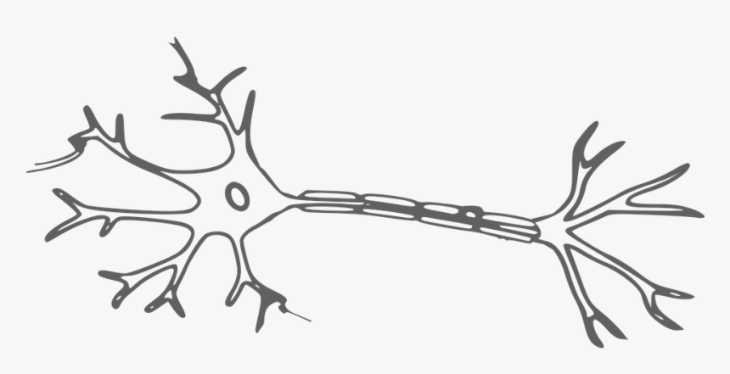
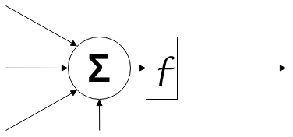
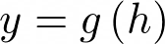
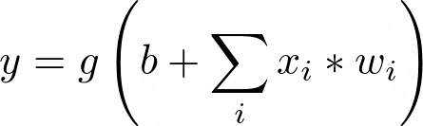
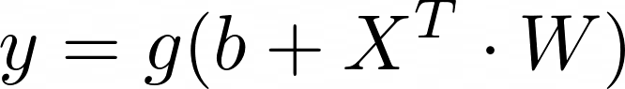
Artificial Neuron
Artificial Neural Networks were modeled after the biological brain and neurons.
Walter Pitts and Warren McCulloch introduced the first mathematical model for the neuron in 1943.
Artificial Intelligence
Machine Learning
x1
w1
x2
w2
h
y
Deep Learning
wn
xn
b
Notes:
Dendrite - Tips for input connections. Receives synapses from other neurons.
Cell Body - Where the received signals converge.
Axon - The converged signal passes through here and generates a new synapse. This part of the cell offers some resistance. So the neuron might or might not generate the synapse. It depends on how strong the input signals are. Exemplify with step function.
Axon Terminals - Connects to other neurons. Sending its synapse to them. Which will go through the same process.
x are inputs. Exemplify with finger touch or other neurons.
w are weights. They dictate the importance of that input.
b is the bias. A constant stimuli on that neuron.
f is the activation function. This dictates if the neuron is firing signals or not. Exemplify with step function.

Slide 13
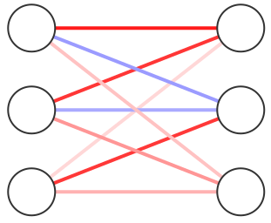
Single-Layer Network
Connections and Weights
Operations and Output
Input
Input Layer
Output Layer
Notes:
Combining multiple neurons together into a layer.

Slide 14
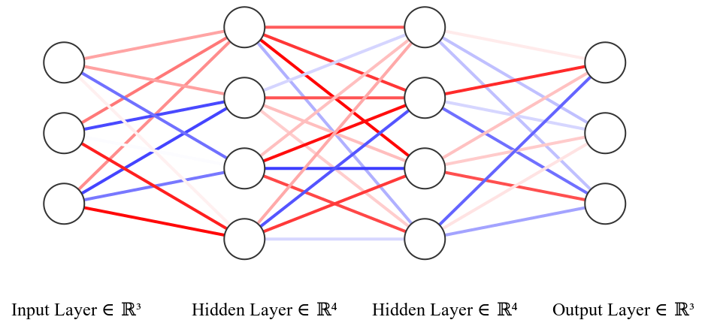
Multi-Layer Neural Network
Notes:
Combining multiple layers into a neural network

Slide 15
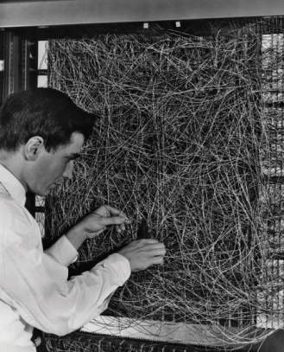
Deep Learning
Frank Rosenblatt had, Ph.D. in psychology.
First engineered single-layer and multi-layer artificial neural networks (1957, 1962).
It was called Rosenblatt’s Perceptron .

Slide 16
How does a network learn?
Stochastic Gradient Descent (SGD) was introduced by Herbert Robbins and Sutton Monro in 1951 with the objective to approximate equations to a specific behaviour.
SGD checks the error of an equation and changes it’s parameters to reduce the error as much as possible over several iterations of the algorithm.
Notes:
Our rules are the weights. The Backpropagation is the way to

Slide 17
How does a network learn?
Backpropagation was introduced to train neural networks by the 1986 paper Nature Learning Representations by Back-propagating Errors by Rumelhart, Hinton and Williams.
Backpropagation allows us to understand how much a codependent parameters will influence each other and influence the error by applying the Chain Rule.
The combination of both algorithms allows change the neural network weights to reduce the error. This is the learning process of the neural network.
Notes:
Our rules are the weights. The Backpropagation is the way to

Slide 18
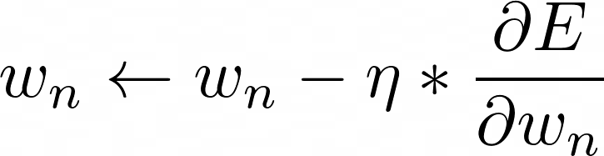
Stochastic Gradient Descent (SGD)
How much does an specific weight influences the overall performance of the neural network ?
How much are we willing to adapt our weights in order to attempt to reduce the error?
Updates Weight
Current
Weight
Learning
Rate
Influence of weight in error
Notes:
Our rules are the weights. The Backpropagation is the way to

Slide 19
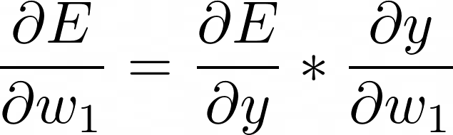
Backpropagation (of error)
How much does a weight influences the error?
Needed to update the weights of the hidden neurons.
Derivative Chain Rule.
w1
Error
y

Slide 20
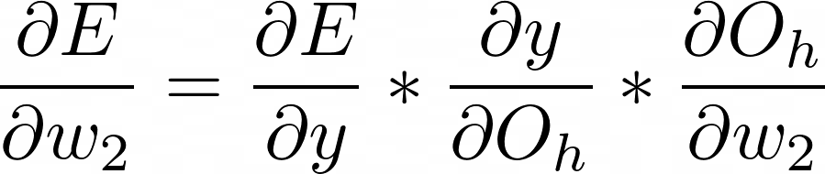
Backpropagation (of error)
How much does a weight influences the error?
Needed to update the weights of the hidden neurons.
Derivative Chain Rule.
w2
w1
Error
y

Slide 21
Backpropagation (of error)
How much does a weight influences the error?
Needed to update the weights of the hidden neurons.
Derivative Chain Rule.
w2
w1
Error
y

Slide 22
SGD and Backpropagation Example
Oh1
Oh2
2
W1 = 0.5
2
X1
X2
η = 0.1
Yp = 1
W5 = 0.5
W2 = 2
Y
e = Y-Yp = -10
11
E = |e| = 10
W3 = 1
1
5
W6 = 2
W4 = 1
Notes:
SGD

Slide 23
SGD and Backpropagation Example
Oh1
Oh2
2
W1 = 0.5
2
X1
X2
η = 0.1
Yp = 1
W5 = 0.3
W2 = 2
Y
11
W3 = 1
1
5
W6 = 2
W4 = 1
Notes:
SGD

Slide 24
SGD and Backpropagation Example
Oh1
Oh2
2
W1 = 0.5
2
X1
X2
η = 0.1
Yp = 1
W5 = 0.3
W2 = 2
Y
11
W3 = 1
1
5
W6 = 1.5
W4 = 1
Notes:
SGD

Slide 25
SGD and Backpropagation Example
Oh1
Oh2
2
W1 = 0.44
2
X1
X2
η = 0.1
Yp = 1
W5 = 0.3
W2 = 2
Y
11
W3 = 1
1
5
W6 = 1.5
W4 = 1
Notes:
SGD

Slide 26
SGD and Backpropagation Example
Oh1
Oh2
2
W1 = 0.44
2
X1
X2
η = 0.1
Yp = 1
W5 = 0.3
W2 = 1.7
Y
11
W3 = 0.94
1
5
W6 = 1.5
W4 = 85
Notes:
SGD

Slide 27
SGD and Backpropagation Example
Oh1
Oh2
2
W1 = 0.44
X1
X2
Yp = 1
W5 = 0.3
W2 = 1.7
Y
W3 = 0.94
1
W6 = 1.5
W4 = 85
Notes:
SGD

Slide 28
SGD and Backpropagation Example
Oh1
Oh2
2
W1 = 0.44
1.82
X1
X2
Yp = 1
W5 = 0.3
W2 = 1.7
Y
e = Y-Yp = -5.921
6.921
E = |e| = 5.921
W3 = 0.94
1
4.25
W6 = 1.5
Before: E = 10
W4 = 85
Notes:
SGD

Slide 29
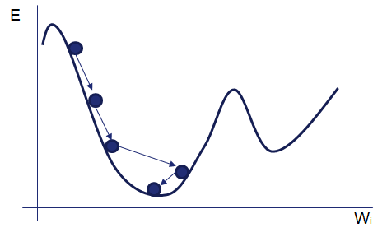
Gradient Exploration
Notes:
SGD

Slide 30
The Tipping Point
Study of neural networks has evolved through the years, but it’s usability was still low.
Heavy computation.
ImageNet Large Scale Visual Recognition Challenge (ILSVRC)
ImageNet is a a dataset with over 15 million separated into 22 thousand categories.
The challenge is to classify a subset of 1000 categories of the ImageNet dataset (about 1.4 million images).
AlexNet (2012)
The first to use Convolutional Neural Networks in the challenge.
Achieved a top-5 error of 15.3%. The next best challenger was far behind with 26.2%.
Notes:
Top-5 error is the percentage of the time that the classifier did not include the correct class among its top 5 guesses.

Slide 31


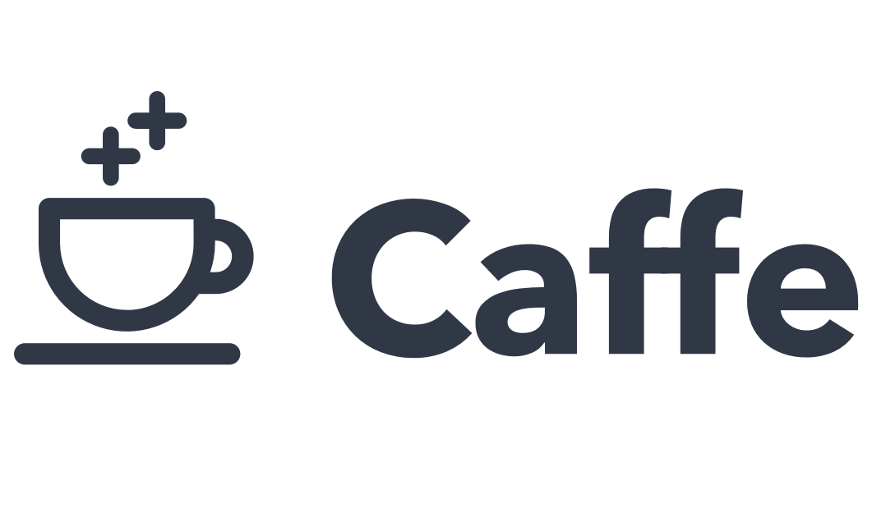




Deep Learning Today
Notes:
Top-5 error is the percentage of the time that the classifier did not include the correct class among its top 5 guesses.

Slide 32
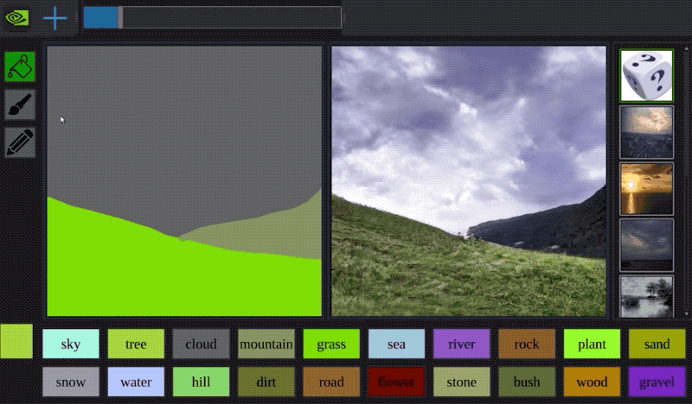
Deep Learning Today

Slide 33

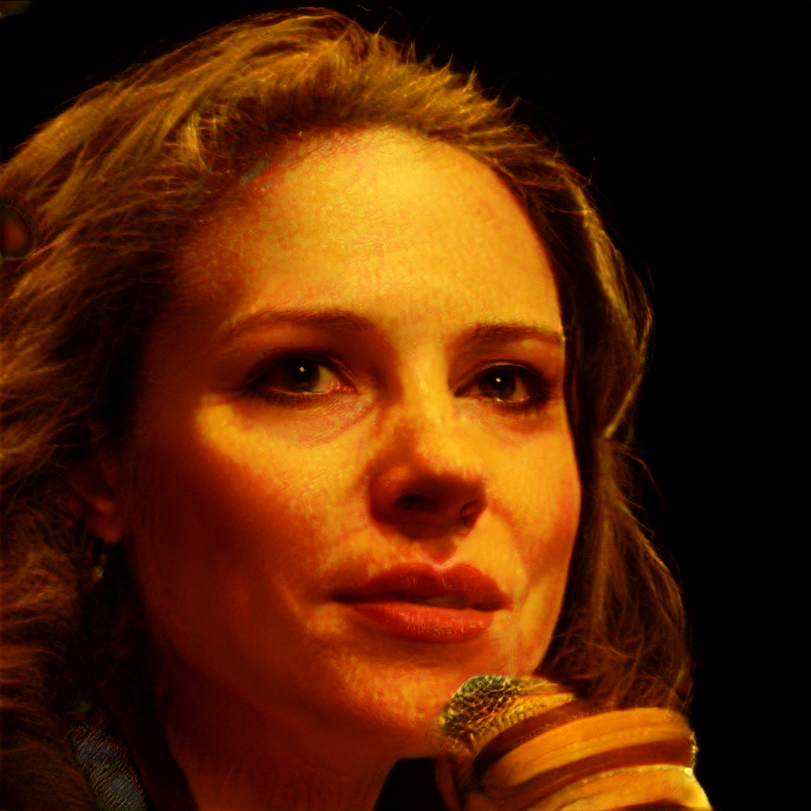


Deep Learning Today
https://thispersondoesnotexist.com
Notes:
Top-5 error is the percentage of the time that the classifier did not include the correct class among its top 5 guesses.

Slide 34

Deep Learning Today

Slide 35
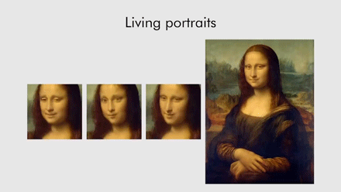
Deep Learning Today

Slide 36
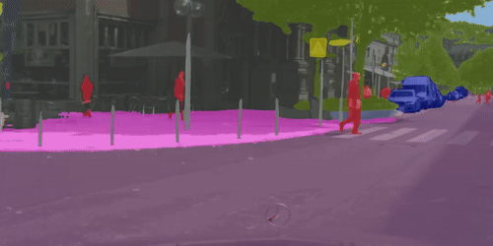
Deep Learning Today

Slide 37
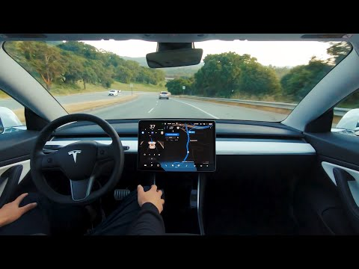
Deep Learning Today

Slide 38
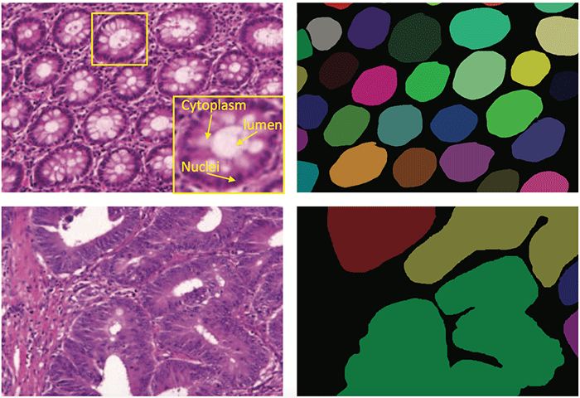
Deep Learning Today

Slide 39

Deep Learning Today

Slide 40
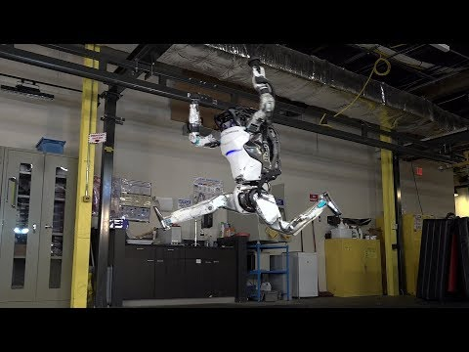
Deep Learning Today

Slide 41
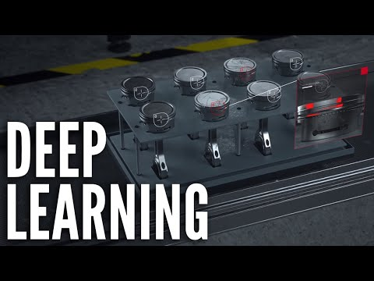
Deep Learning Today

